Slide 1
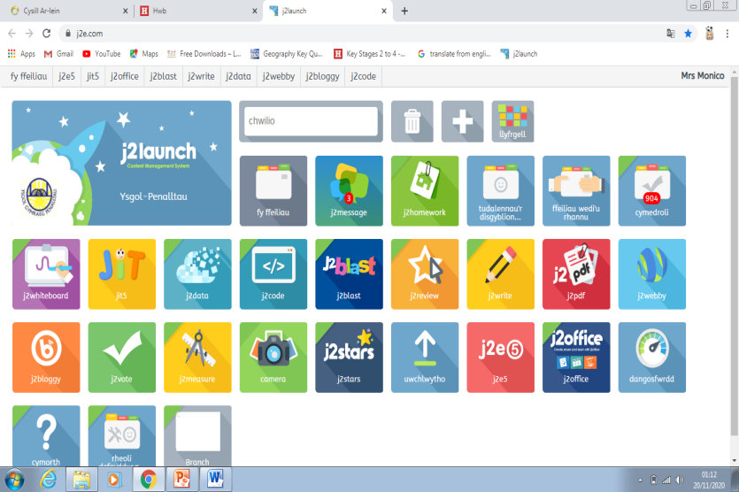
How to access JIT5
First log onto Hwb Cymru
You can then change the language here.
Scroll down to the bottom of the page then double click on the J2Launch application. The J2Launce page will then pop up.
Then click on the Support App .
You will need to click onto the App.
P.T.O

Slide 2
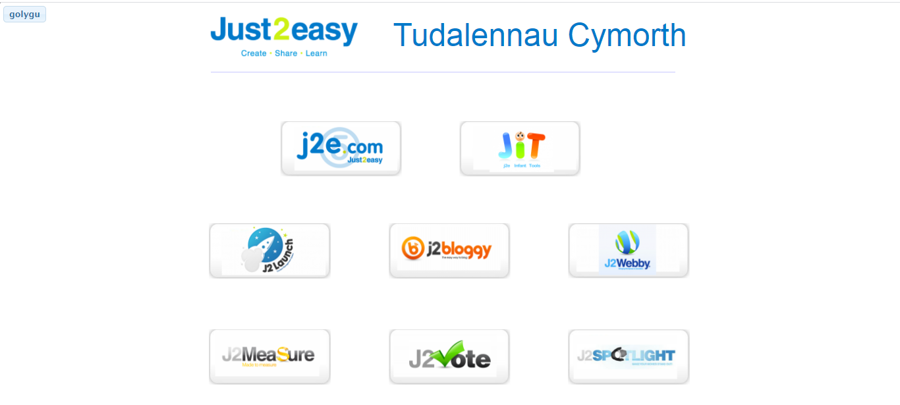
This page will open in a separate tab. Below you will see a variety of different buttons. Please click on the JIT5 button
This will take you to a film information guide. Turn your volume up and listen and watch.

Slide 3
Once you’ve finished watching the video please close the tab at the top of the page. Your J2Launch menu should still be there.
Check out the challenges I have provided in your child’s Year 1 folder- Dated 23of November.
After reading the challenges click back to the J2Launch menu and click on the JIT5 App.

