Slide 1
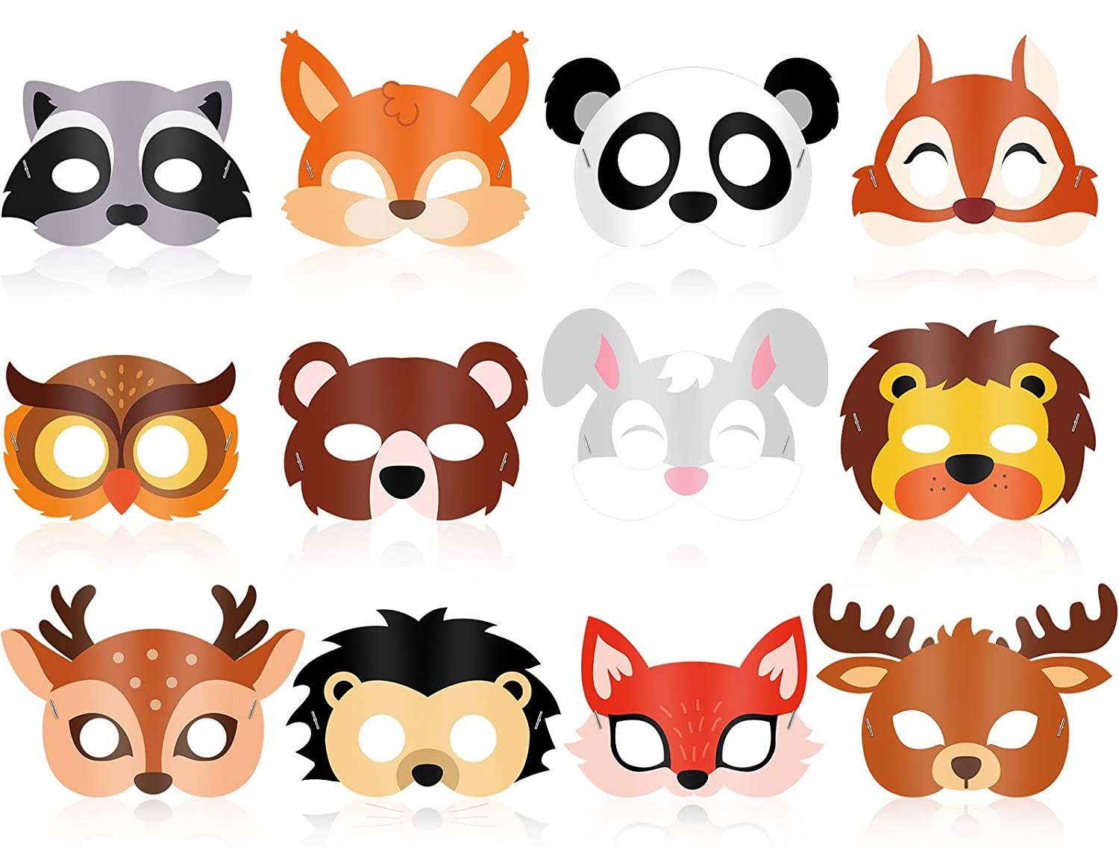
Creadigol / Creativity
Why not try and make your own forest animal mask. You could use anything around the hone i.e. cereal boxes, newspaper, magazines
Beth am geisio gwneud eich mwgwd anifail coedwig eich hun. Fe allech chi ddefnyddio unrhyw beth o gwmpas yr hone h.y. bocsys grawnfwyd, papur newydd, cylchgronau

